Slide 1
Privacy: Not Just For Your Local Drug Dealer
Kasha Muzila
Karl Eirich
Notes:
https://www.sciencedirect.com/science/article/pii/S0736585320300885
https://nypost.com/2017/05/03/crafty-drug-dealers-posed-as-uber-drivers-to-avoid-detection-cops/
https://www.addictioncenter.com/community/dating-apps-peddle-drugs/

Slide 2
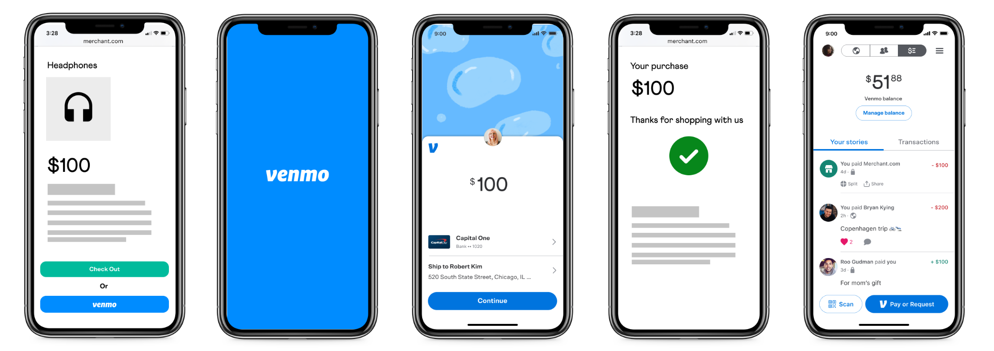
What is Venmo?
Notes:
https://www.zdnet.com/article/online-security-101-how-to-protect-your-privacy-from-hackers-spies-and-the-government/
https://help.venmo.com/hc/en-us/articles/221011388-What-is-Venmo-
https://venmo.com/
Personal privacy is no longer an intrinsic right but an active struggle as the world becomes more connected and surveilled by the day
Personal privacy is no longer an intrinsic right but an active struggle as the world becomes more connected and surveilled by the day

Slide 3
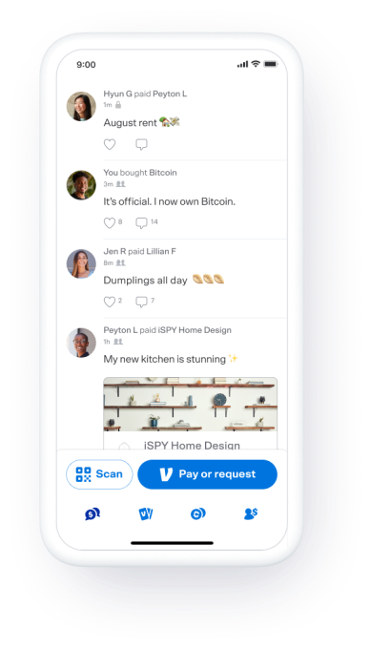
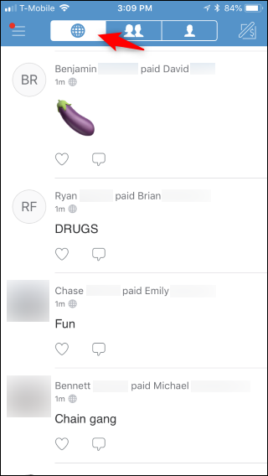
Venmo’s Privacy Policy
Notes:
https://www.cnet.com/news/privacy/venmo-explains-why-transactions-are-public-by-default/
https://www.howtogeek.com/362225/how-to-make-your-venmo-transactions-private/
https://help.venmo.com/hc/en-us/articles/210413717-Payment-Activity-Privacy#:~:text=When%20a%20payment%20is%20shared,visible%20on%20the%20public%20feed

Slide 4
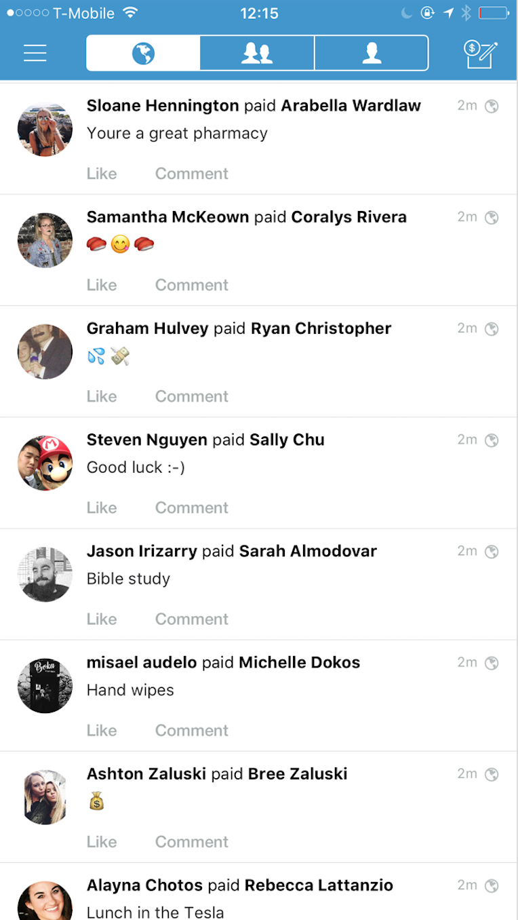
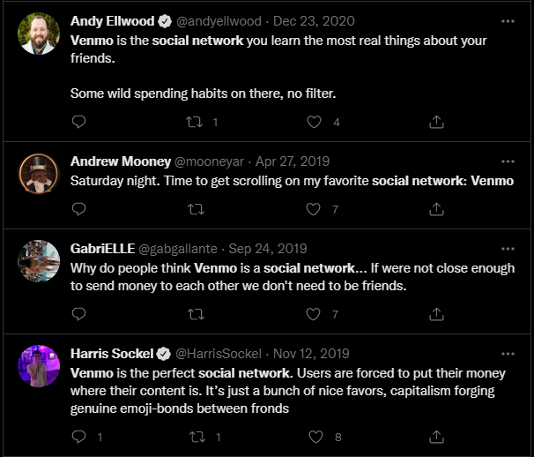
Potential Privacy Threats
Inference Threat
Identity Disclosure
Membership Disclosure
Notes:
https://www.theatlantic.com/culture/archive/2014/04/why-the-venmo-newsfeed-is-the-best-social-network-nobodys-talking-about/361342/
https://time.com/83200/privacy-internet-big-data-opt-out/

Slide 5
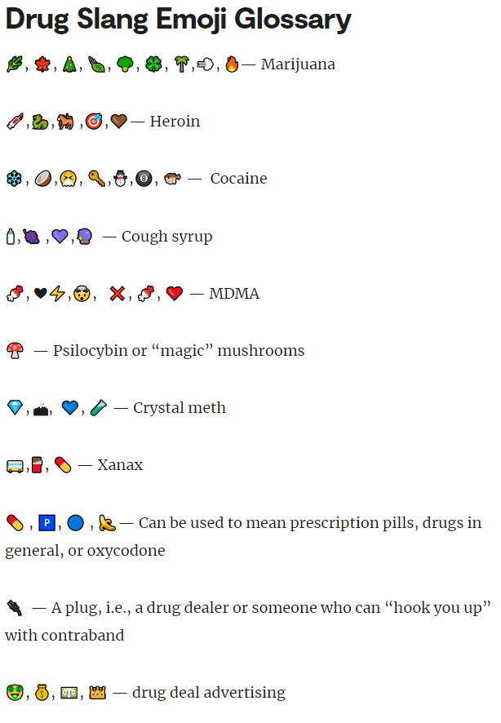
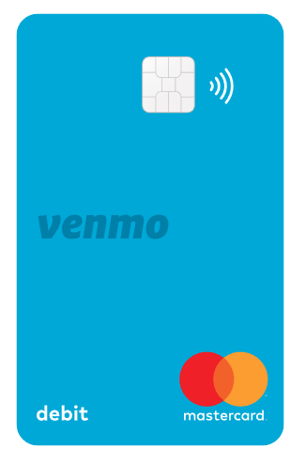
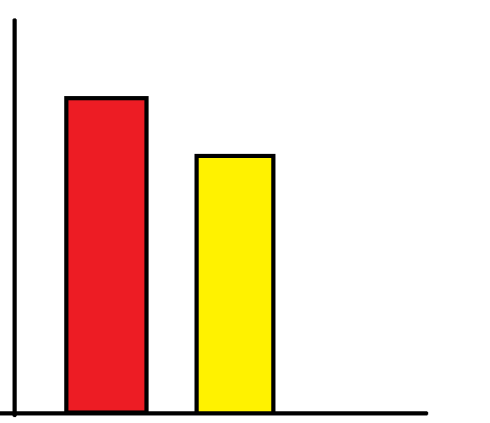
Drug Dealers have more Privacy
Notes:
https://nypost.com/2022/06/14/secret-emoji-slang-teens-use-to-make-drug-deals-revealed/

Slide 6
Venmo Transaction Dataset
Each transaction contains:
Payment object
Actor object
Note
Transaction Type
Comment Object
App Object
Over 7 Million transactions
Gathered between mid 2018 and early 2019
Notes:
https://www.yahoo.com/video/venmo-transactions-public-private-110013391.html#:~:text=While%20payment%20amounts%20are%20not,doubles%20as%20a%20social%20network.

Slide 7
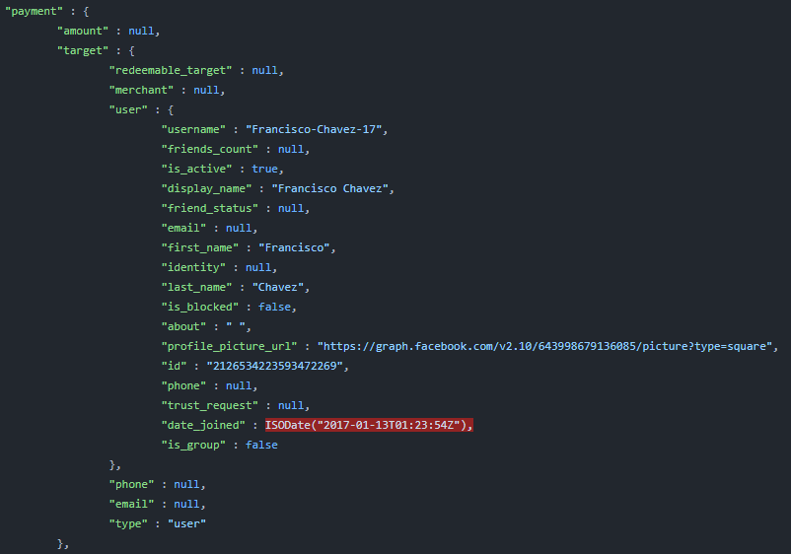
Target & User Object
Target
User
Username
Display name
First name
Last name
About (bio)
Facebook ID
ID
Notes:
https://www.cnet.com/personal-finance/9-venmo-settings-you-should-change-right-now-to-protect-your-privacy/

Slide 8
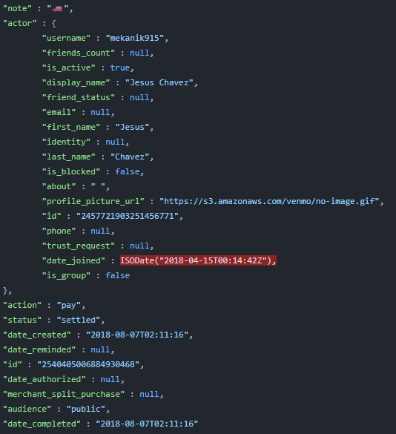
Actor & Payment Object
Actor
Similar to Target
Payment
Note
Action
Status
Audience
Date Created
Date Completed
Notes:
https://www.howtogeek.com/362225/how-to-make-your-venmo-transactions-private/

Slide 9


Identifying Drug Transactions
DEA provides common drug emoji slang mapping
Most transactions are ambiguous
Hyperlocal slang can make identification difficult
Notes:
https://www.dea.gov/sites/default/files/2021-12/Emoji%20Decoded.pdf
https://home.iape.org/resourcesPages/IAPE_Downloads/Drugs/DEA-s-List-of-Drug-Slang-and-Code-Words.pdf

Slide 10
True Positive Emojis
False Positive Emojis
🎱
🍄
👃
💊
⛷
💎
⚡
Notes:
https://www.npr.org/2007/10/31/14470003/ex-drug-officer-shows-users-how-to-avoid-arrest

Slide 11
2.84
1.04
The average number of transaction received by a normal user
The average number of transaction received by a Drug Dealer
Notes:
https://www.complex.com/pop-culture/2013/12/10-technologies-drug-dealers-need-to-stay-out-of-jail/

Slide 12
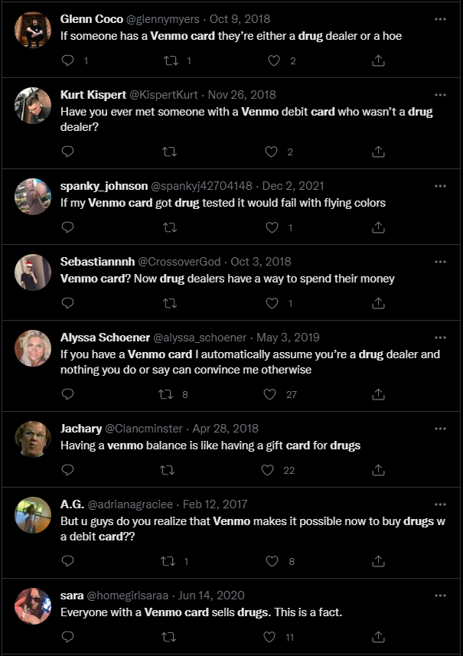
Venmo Card
Dataset doesn’t contain Venmo Card info
Personal friendships and Twitter feedback states its use for drug dealing
Notes:
https://www.sciencedirect.com/science/article/pii/S0955395916303140

Slide 13
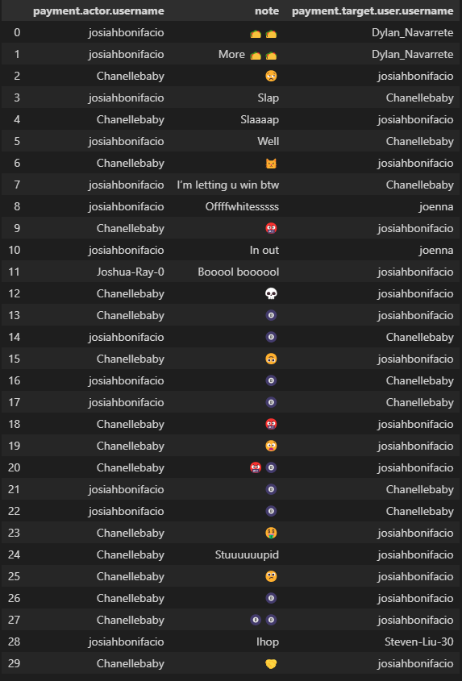
A Unique Challenge to Privacy
The rise of cashless services increases the necessity of venmo
As a result, the platform provides an intimate look at people's relationships
Notes:
https://www.forbes.com/sites/paularmstrongtech/2018/07/22/why-venmo-is-not-a-social-network-and-shouldnt-want-to-be-one/?sh=65eae79e5f4d
https://www.pewresearch.org/internet/2019/11/15/americans-and-privacy-concerned-confused-and-feeling-lack-of-control-over-their-personal-information/

Slide 14
Remediations & Suggestions
Venmo can do better by making data private by default
Throttle venmo API and stratify data access controls
Add more granular privacy controls
Increase frequency of privacy setting review friction
Venmo removed global social feed in 2021
Also, added controls to hide friends list
Notes:
https://www.theverge.com/2021/7/20/22585467/venmo-removes-global-social-feed-private-payments
https://www.theverge.com/2021/5/28/22459163/venmo-privacy-controls-friends-list-joe-biden
https://www.cnet.com/news/privacy/venmo-explains-why-transactions-are-public-by-default/
https://securityboulevard.com/2022/08/modern-apis-need-a-different-security-approach/

Slide 15
Q&A
Notes:
https://www.nbcnews.com/id/wbna3078835
https://www.brookings.edu/research/police-surveillance-and-facial-recognition-why-data-privacy-is-an-imperative-for-communities-of-color/
https://www.propublica.org/article/a-former-hackers-guide-to-boosting-your-online-security

Slide 16
Introduction
Personal privacy is no longer an intrinsic right but an active struggle as the world becomes more connected and surveilled by the day
The average individual can learn from criminals how to maintain privacy while interact with digitals systems
Notes:
https://www.zdnet.com/article/online-security-101-how-to-protect-your-privacy-from-hackers-spies-and-the-government/
https://help.venmo.com/hc/en-us/articles/221011388-What-is-Venmo-
https://venmo.com/
Personal privacy is no longer an intrinsic right but an active struggle as the world becomes more connected and surveilled by the day
Personal privacy is no longer an intrinsic right but an active struggle as the world becomes more connected and surveilled by the day

Slide 17
Venmo: Capitalism’s Social Network
Venmo shares transactions by default
The platform recently stopped sharing public transactions globally
Notes:
https://www.cnet.com/news/privacy/venmo-explains-why-transactions-are-public-by-default/
https://www.howtogeek.com/362225/how-to-make-your-venmo-transactions-private/
https://help.venmo.com/hc/en-us/articles/210413717-Payment-Activity-Privacy#:~:text=When%20a%20payment%20is%20shared,visible%20on%20the%20public%20feed

Slide 18
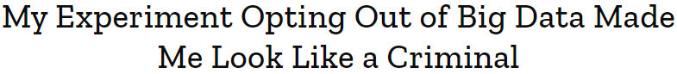
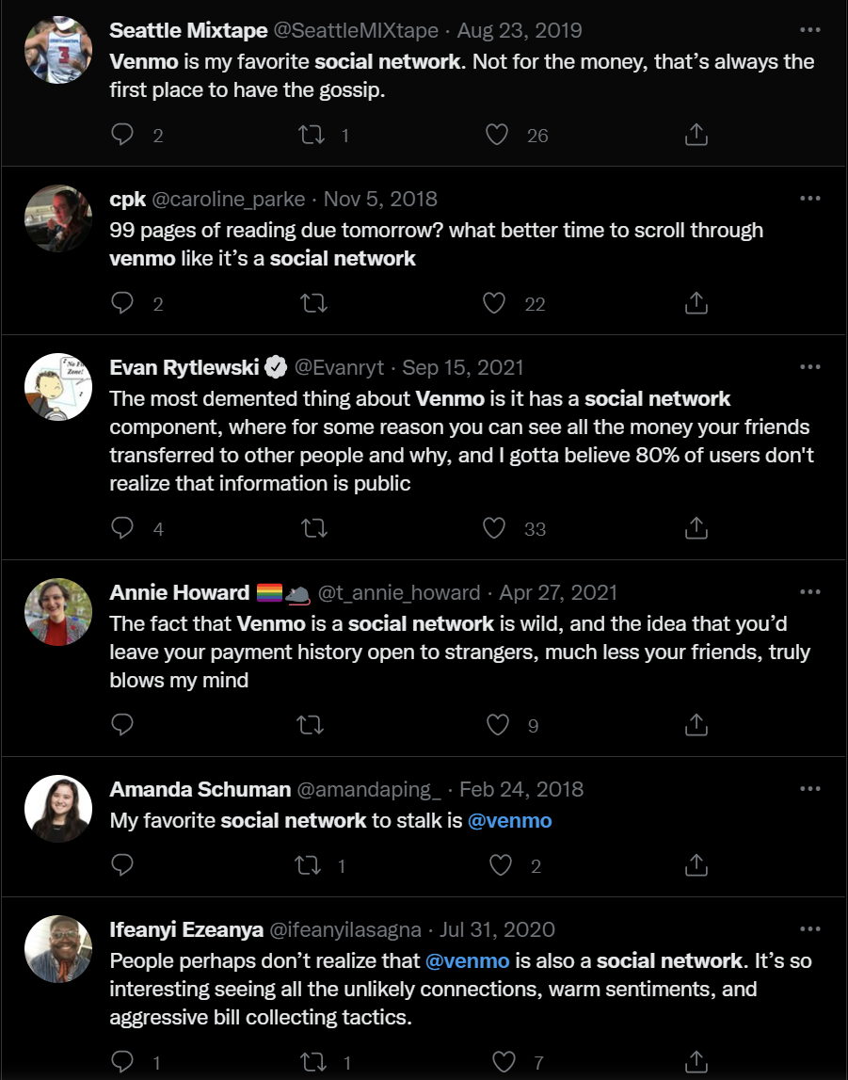
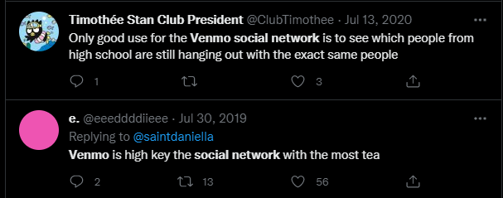
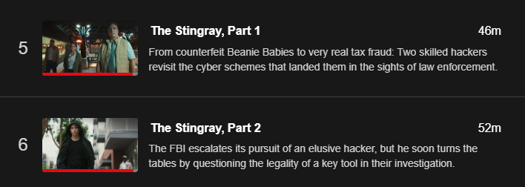
Introduction
Through the evaluation of criminal behavior we can improve personal privacy
Notes:
https://time.com/83200/privacy-internet-big-data-opt-out/

Slide 19
Inference Threat
Membership Disclosure

Slide 20
Get involved:
Explore:
Student government
Student groups
Athletics
Campus jobs
Art and culture
Regional parks
Public transportation
Food and drink

Slide 21
UC Berkeley is a hub of innovation.

Slide 22
We’re the #1 public university
At Berkeley, we address the biggest challenges of the day to create a better world. From robotic legs to the origins of the universe, research at Berkeley illuminates new ideas.
Berkeley is home to some of the world’s greatest minds.

Slide 23
“I love Berkeley. Our students give me hope for the future.”
Robert Reich, professor of public policy

Slide 24
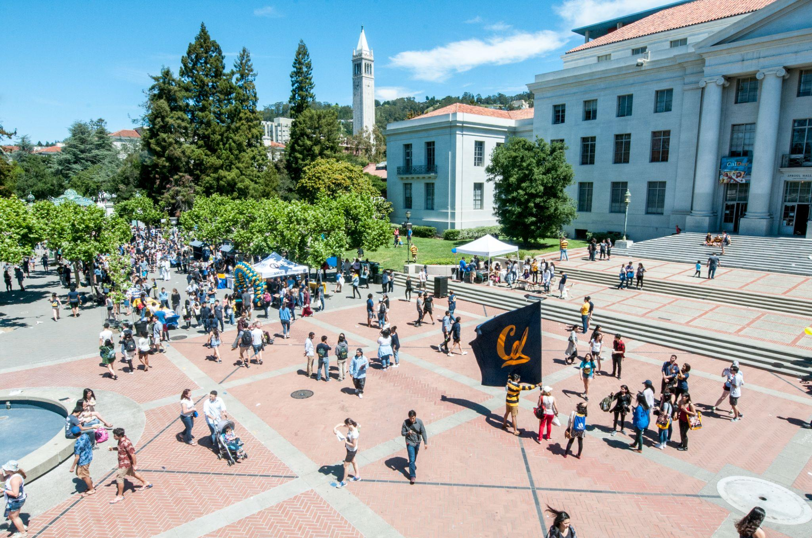
Sproul Plaza is at the heart of campus life at UC Berkeley.

Slide 25
23%
5,300
Freshman who are first-generation college students
Undergraduates who engage in off-campus public service projects and programs annually

Slide 26

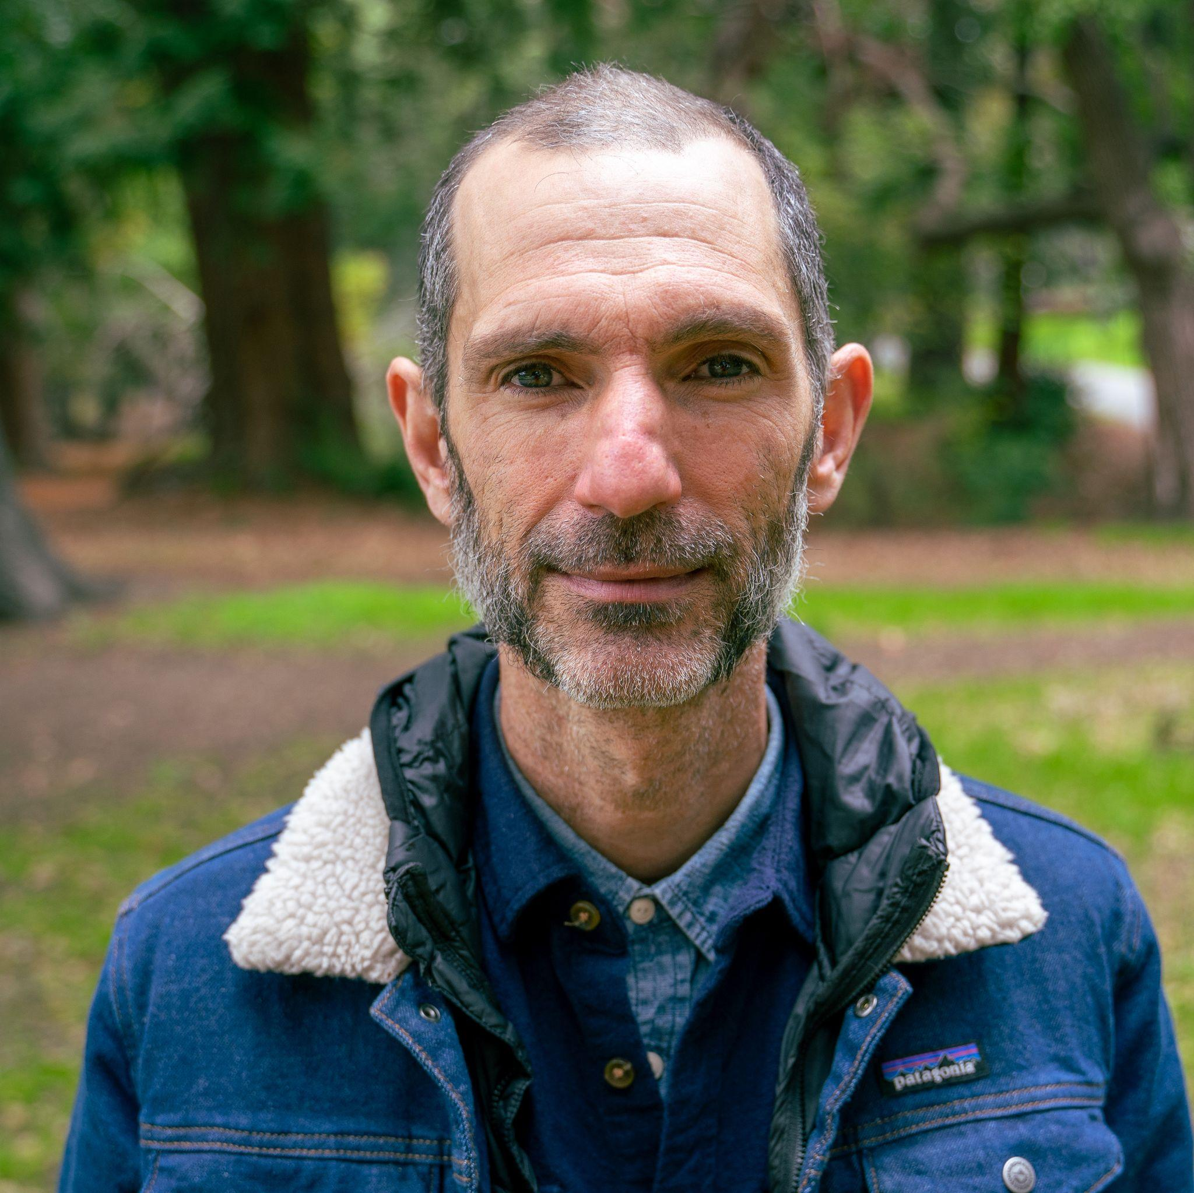
Erica Bree Rosenblum, Ph.D.
Sean Burns, Ph.D.
Faculty Director, Berkeley Discovery
Director, Center for Undergraduate Discovery

